Slide 1
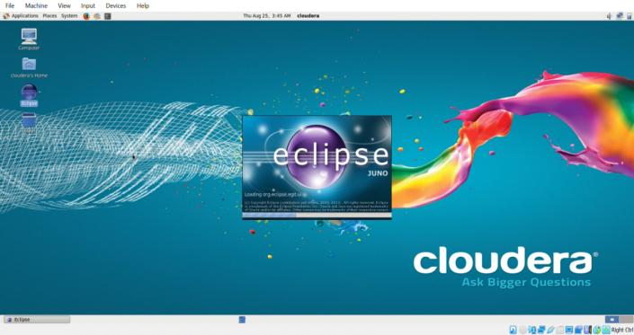
Aim:Run a basic Word Count MapReduce program to understand MapReduce Paradigm.
Open Oracle VM Virtual box -> click start -> open cloudera -> open eclipse.

Slide 2
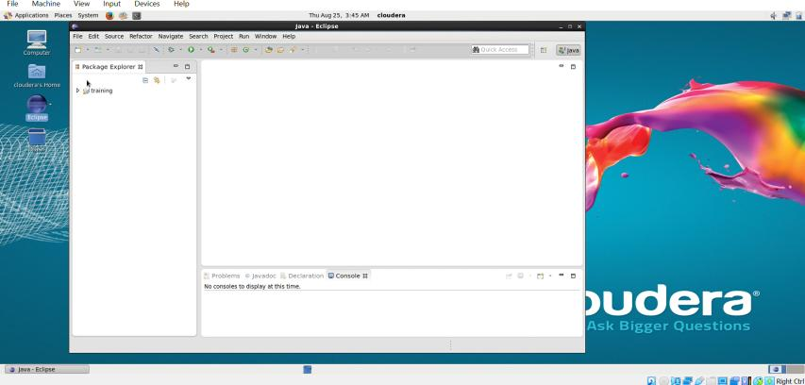

Slide 3
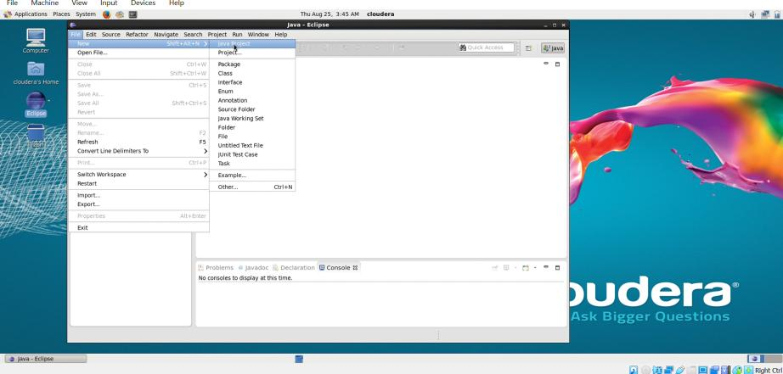
Click on file->New->Java Project

Slide 4
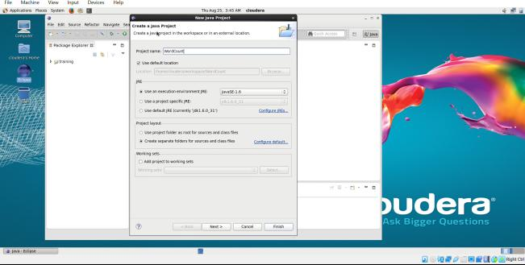
Give your project name as “WordCount” and click on next.

Slide 5
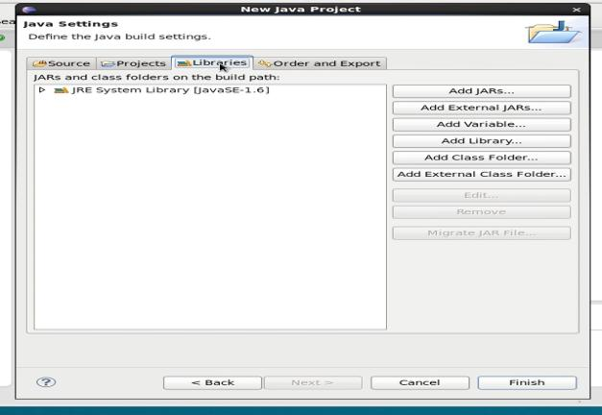
After that, click on libraries on the top and click on add external jars on the right side

Slide 6
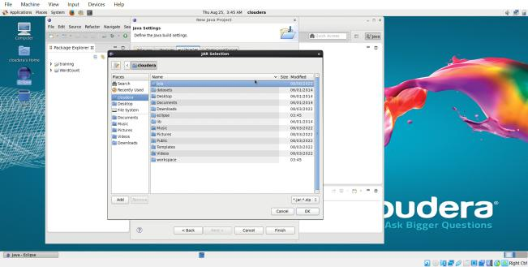
A dialog box will appear.

Slide 7
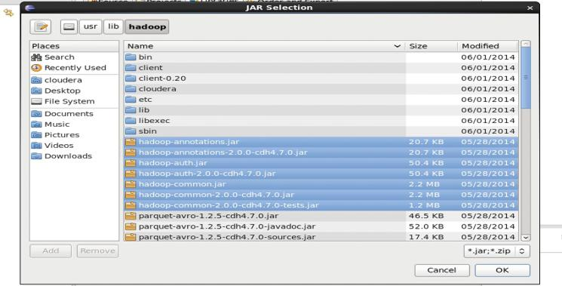
Click on file system on the left, and then usr->lib ->hadoop. Select all the files named with hadoop and click ok.

Slide 8
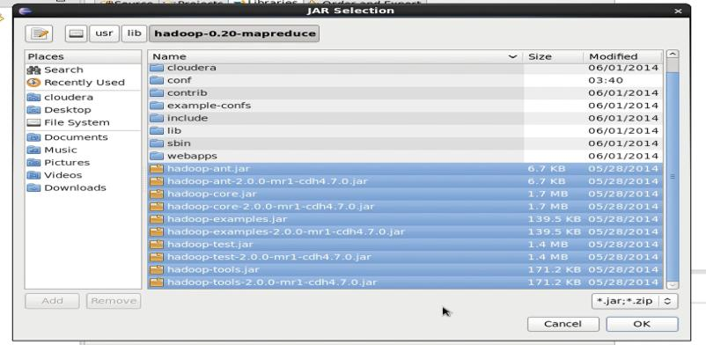
Go back to lib and click hadoop-0.20-mapreduce and select all the files named with hadoop and click ok.

Slide 9
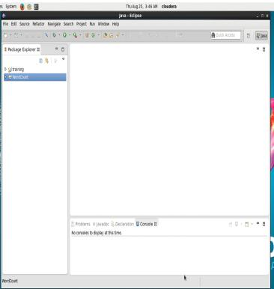
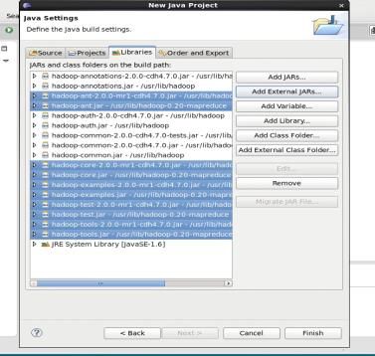
All the external files are added and now click on finish. The project is created successfully.

Slide 10
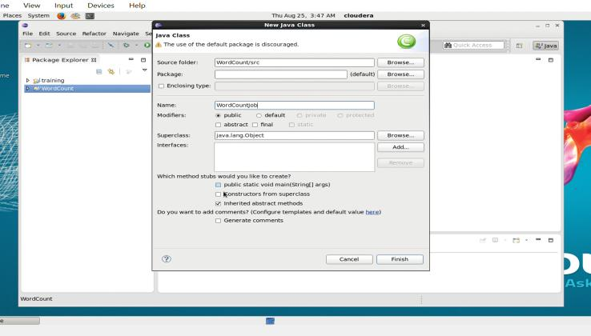
Create a class with name “WordCountJob”

Slide 11
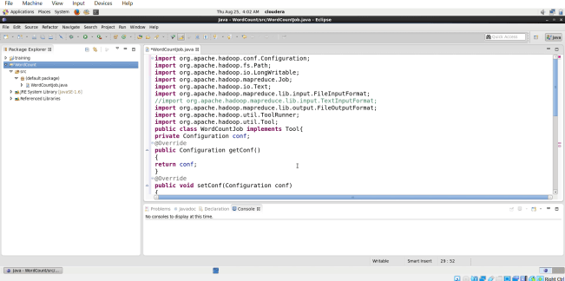
Copy and paste the program 4 lines at a time- If copy and paste doesn’t work then goto device in cloudera and set both shared clipboard and drag and drop as bidirectional.

Slide 12
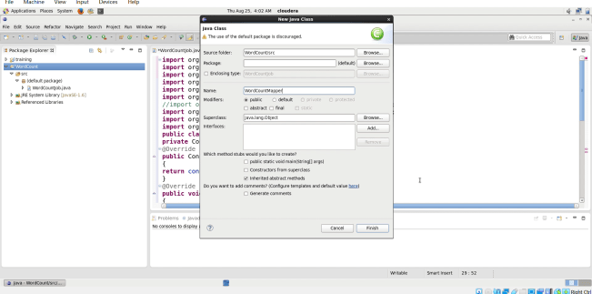
Create another class “WordCountMapper”

Slide 13
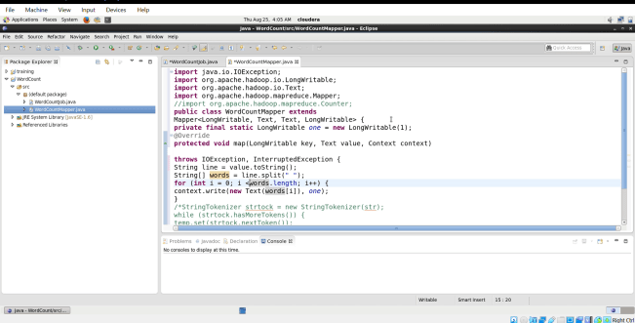
Copy and paste the program

Slide 14
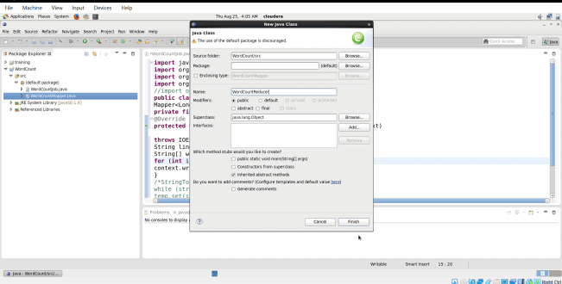
Create another class “WordCountReducer”

Slide 15
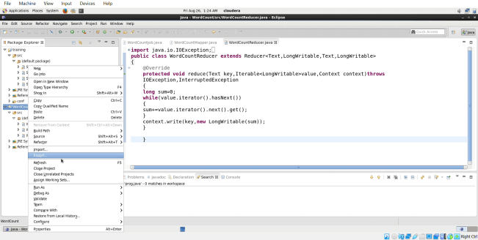
After finishing all the programs, right click on your project and select export.

Slide 16
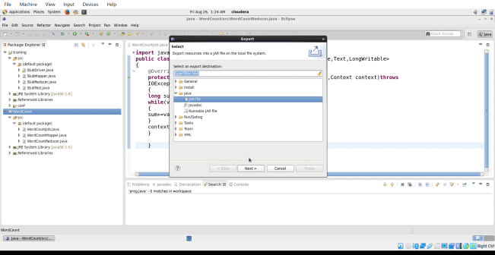
Select java-> JAR file->next

Slide 17
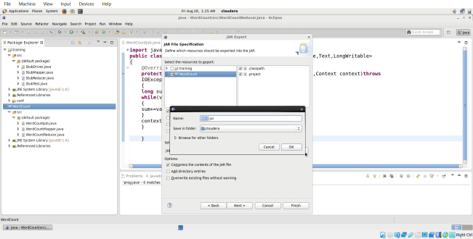
Click on browse and a dialog box will appear, give any name for the jar file and click ok.

Slide 18
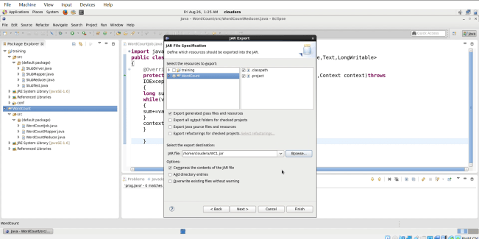
Click on finish.

Slide 19
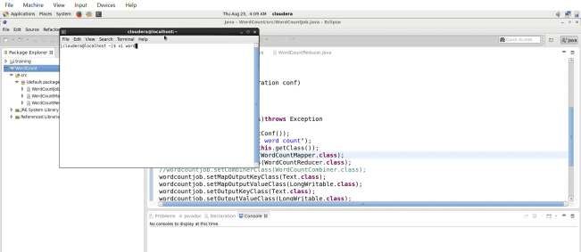
Now, open the terminal and create a text file “word”.

Slide 20
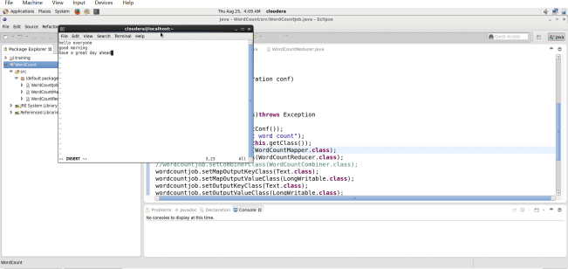
Insert few sentences in the file.

Slide 21
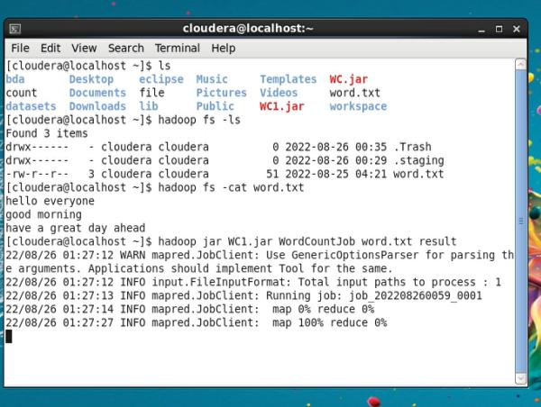

Slide 22
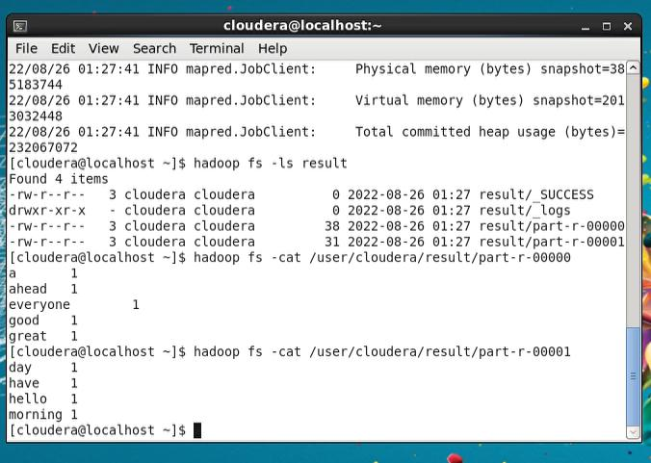

Slide 23
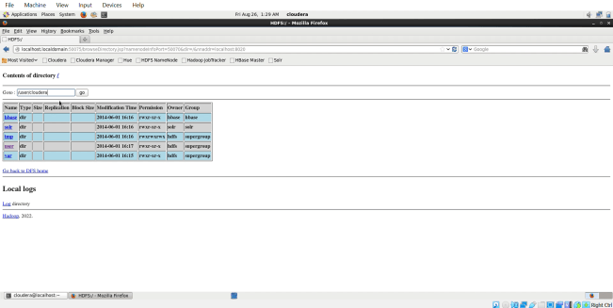
OUTPUT:

Slide 24
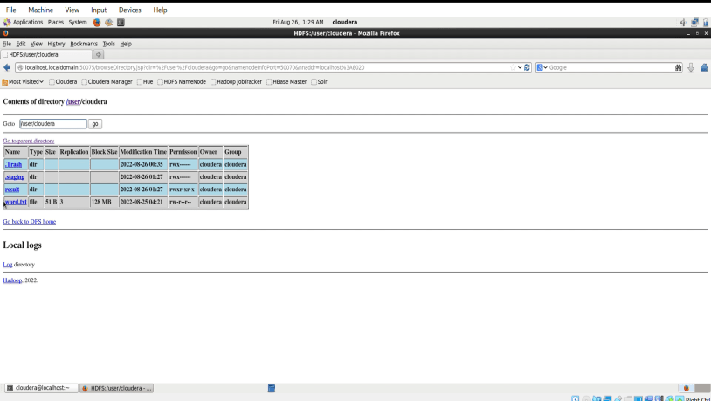

Slide 25
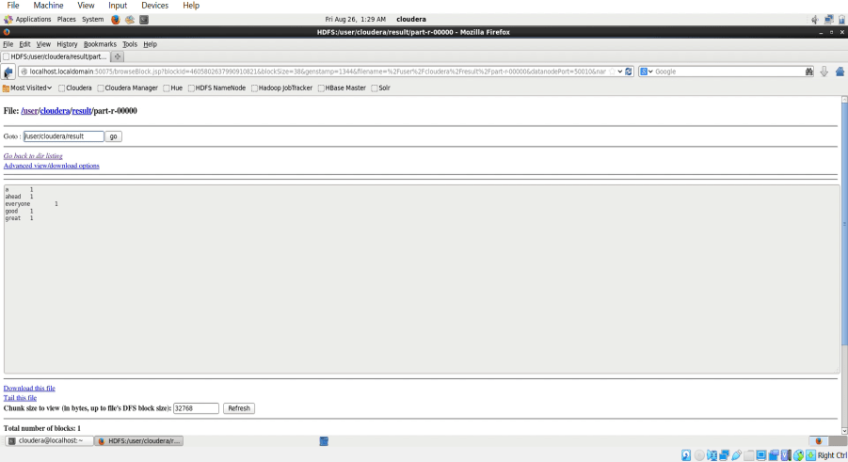

Slide 26
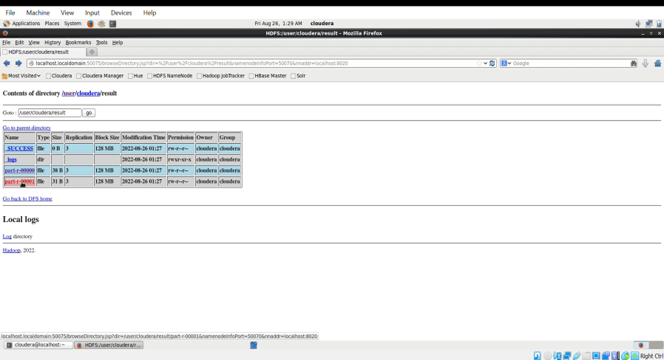

Slide 27
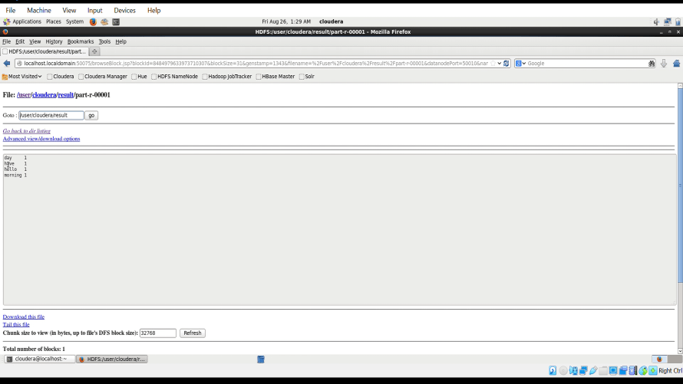

Slide 28
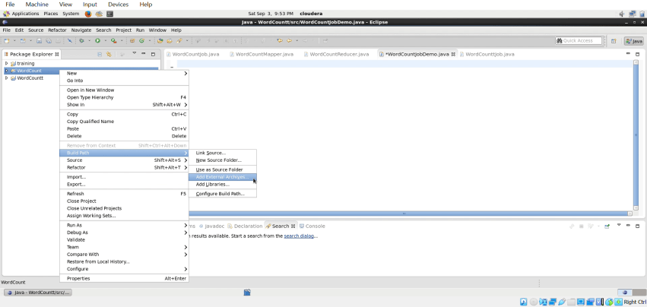
If there is any error in executing then set the path- right click on your project->build path->add external archives

Slide 29
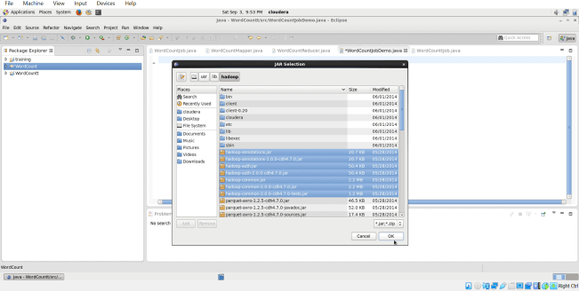
Add all the hadoop and mapreduce external jar files and click ok.

